Slide 1

Presentation of Design & Manufacturing II
An Obstacle Avoidance & Tracking & Loading Vehicle Based on OpenMV
何润 / 曾嘉龙 / 田若瑶 / 方略 / 宋雨辰 / 齐睿
2022/06/10

Slide 2
Contents
Introduction (30s)
obstacle avoidance (1.5 mins)
Tracking (2 mins)
Grasping & Loading (2 mins)
Conclusion (30s)
Q&A (2 mins)

Slide 3
1
Introduction
何润 / 曾嘉龙

Slide 4
Introduction
Objective: Build a smart autonomous carrier robot.
Path tracking
Obstacle avoidness
Cargo detection and classification
Taking cargo
Loading and unloading
Main function:

Slide 5
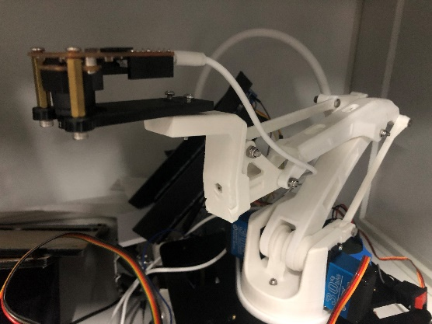
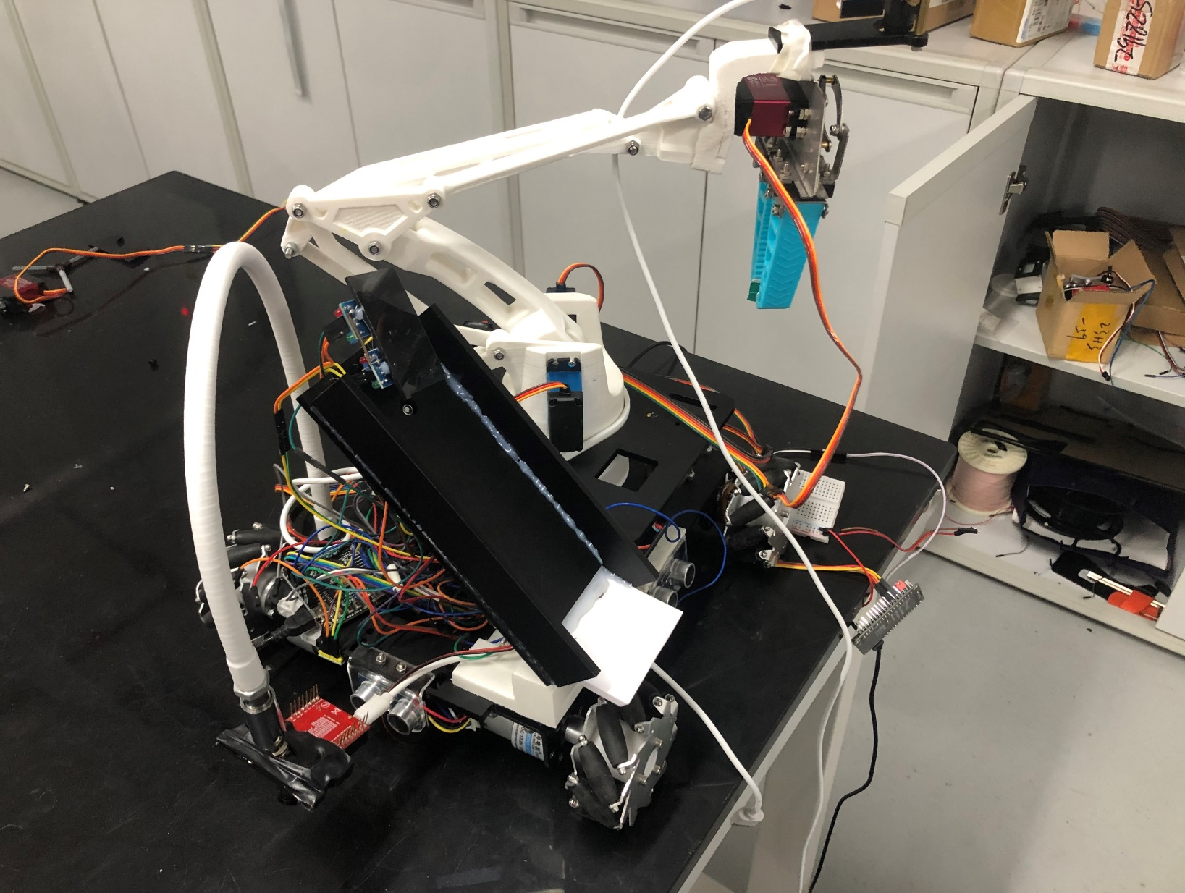
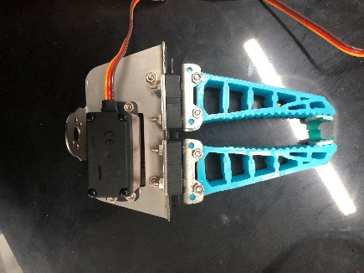
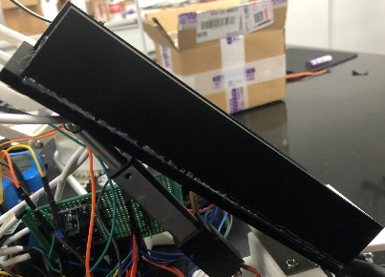
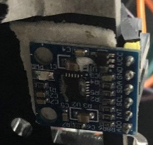
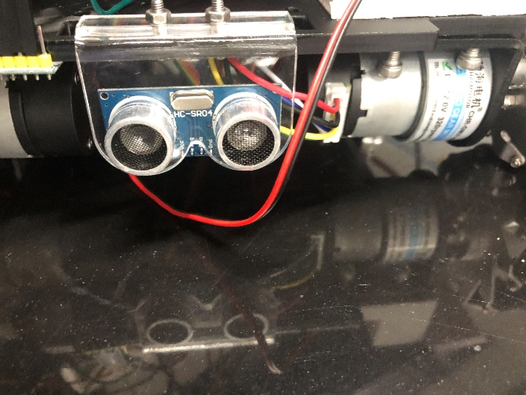
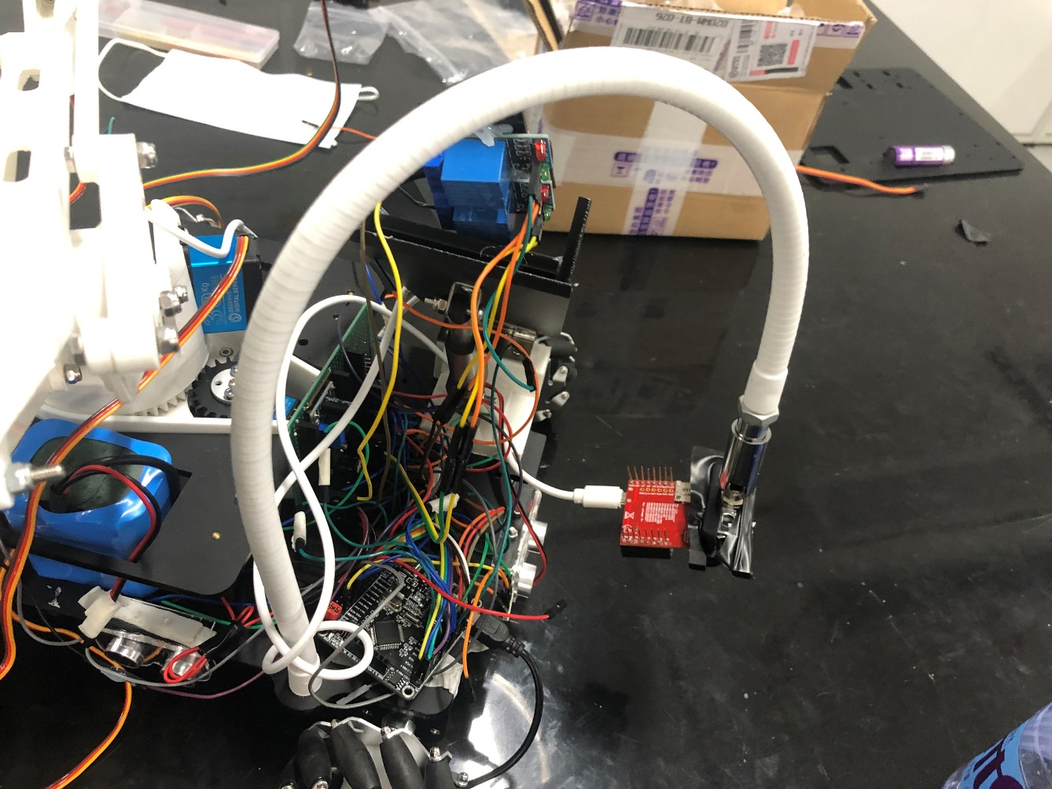
Introduction
Robotic arm and openmv on top of the arm
-> Identifying and grabing objects
Unloading bin
->Unloading the object
Ultrasonic module +encoders
-> Obstacle avoidance
An overview of the car
Openmv in the front of the car
->Line tracking

Slide 6
2
Obstacle Avoidance
何润 / 曾嘉龙

Slide 7
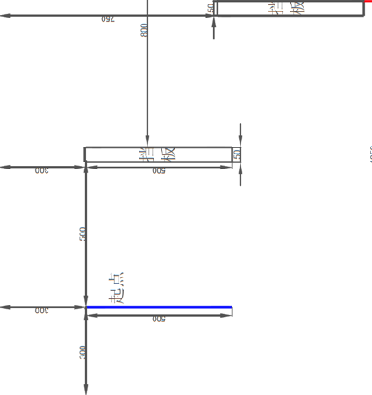
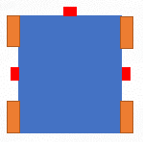
Obstacle Avoidance
Moving Directions: Forward, Left and Right.
Ultrasonic sensor
Car body
Mecunum wheels
Three ultrasonic sensors are set to detect the
distance at certain directions.
For a fixed map, we planned a path as:
Forward
Right
Forward
Left

Slide 8
Obstacle Avoidance
To move without rotation:
Speed of wheels should be equal,
Difficult to obtain with open loop control.
Add encoders as feedback
Design a PD controller.
Control loop:
Tuning:
Kp= 0.15
Kd=0.15
Set speed
Error
PD Controller
Voltage
Wheel
Speed
+
-
Encoder
Goal with sampling time as 0.1s:
Fast response.
Less overshoot.

Slide 9
3
Tracking
田若瑶 / 方略

Slide 10
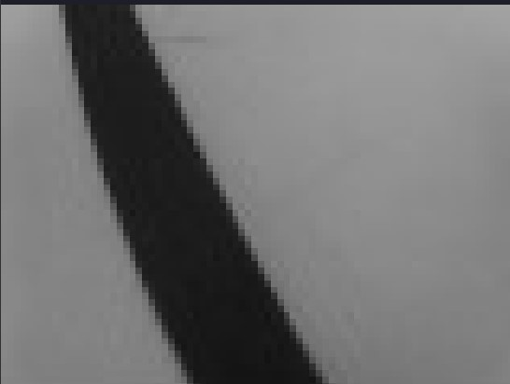
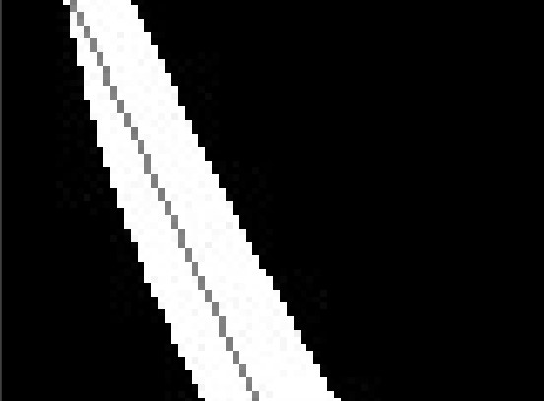
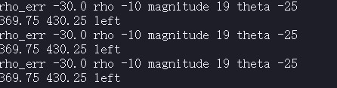

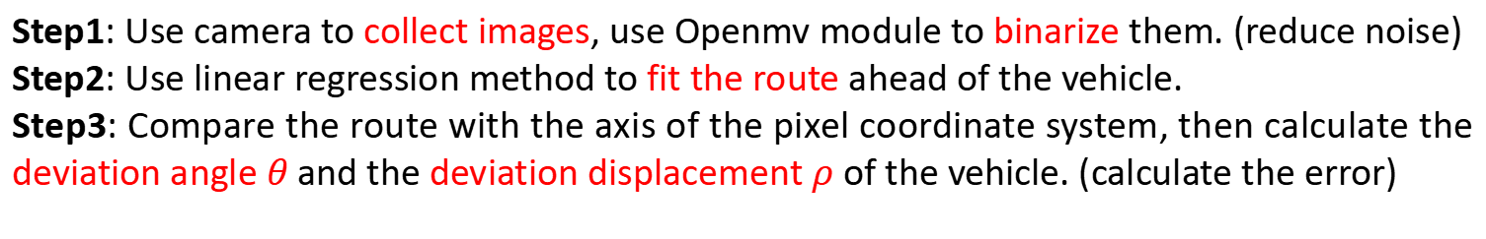
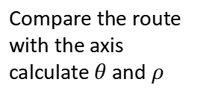

Tracking
Step1: Use camera to collect images, use Openmv module to binarize them. (reduce noise)
Step2: Use linear regression method to fit the route ahead of the vehicle.
Step3: Compare the route with the axis of the pixel coordinate system, then calculate the deviation angle $θ$ and the deviation displacement $ρ$ of the vehicle. (calculate the error)
Collect Images
Binarization
Fit the route
Compare the route with the axis
calculate $θ$ and $ρ$
Print out
$θ$
$$ρ$$
Image processing

Slide 11
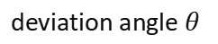
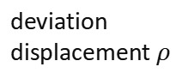
Tracking
Step4: Input the errors into PID controller, adjust the controller parameters, then get the appropriate control output.
Step5: Based on the control output of PID controller, calculate the voltage duty ratio. Finally, pass them to MCU.
Openmv
errors
Image processing
Error calculator
camera
raw information
images
Left voltage duty ratio
deviation angle $θ$
PID Controller
Control output 1
+
Control output
PWM Calculator
stm32
deviation displacement $ρ$
PID Controller
Control output 2
+
Right voltage duty ratio

Slide 12
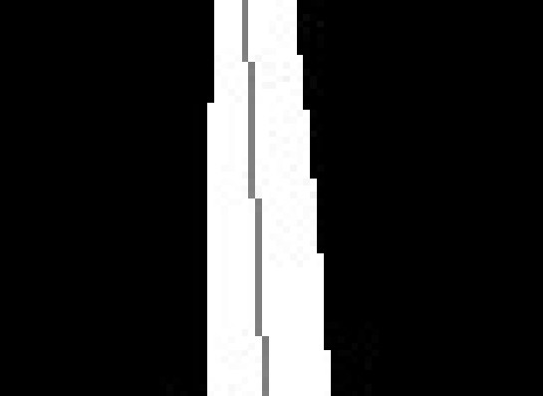
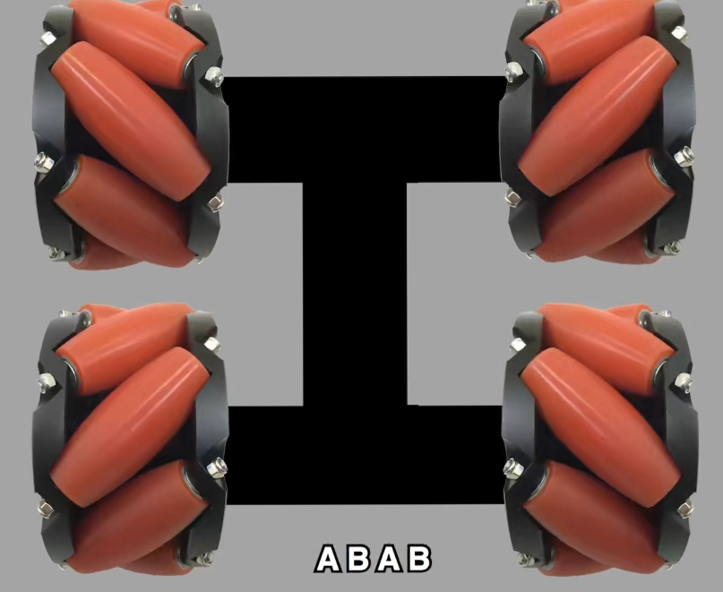
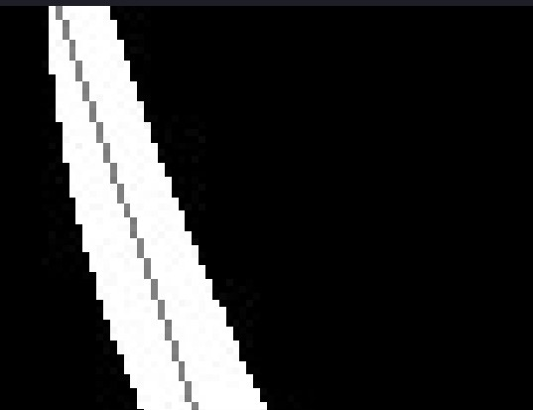
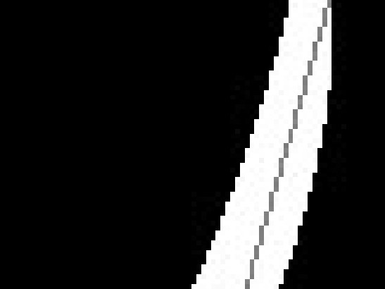
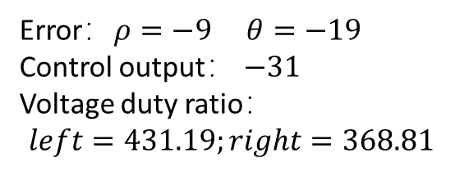
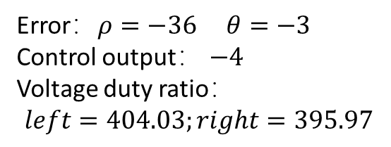
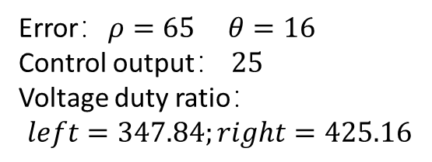
Tracking
What is the relationship between the errors and the voltage duty ratio of motors?
Error：$ρ=−36 θ=−3$
Control output： $−4$
Voltage duty ratio：
$$left=404.03;right=395.97$$
1) Moving forward 2) Moving backward
Error：$ρ=−9 θ=−19$
Control output： $−31$
Voltage duty ratio：
$$left=431.19;right=368.81$$
Error：$ρ=65 θ=16$
Control output： $25$
Voltage duty ratio：
$$left=347.84;right=425.16$$
4) Rotate clockwise + straight
3) Rotate counterclockwise + straight

Slide 13
Tracking
Step6: Stm32 receives information of Openmv and generate PWM to control L298n.
Step7: L298n applies corresponding voltage to the motor according to PWM from stm32.
Left voltage duty ratio
stm32
applies corresponding voltage
generate PWM
L298n (front wheels)
Front motors
Right voltage duty ratio
L298n (back wheels)
applies corresponding voltage
generate PWM
Back motors
One l298n controls front wheels, the other l298n controls back wheels.

Slide 14
4
Grasping & Loading
宋雨辰 / 齐睿

Slide 15
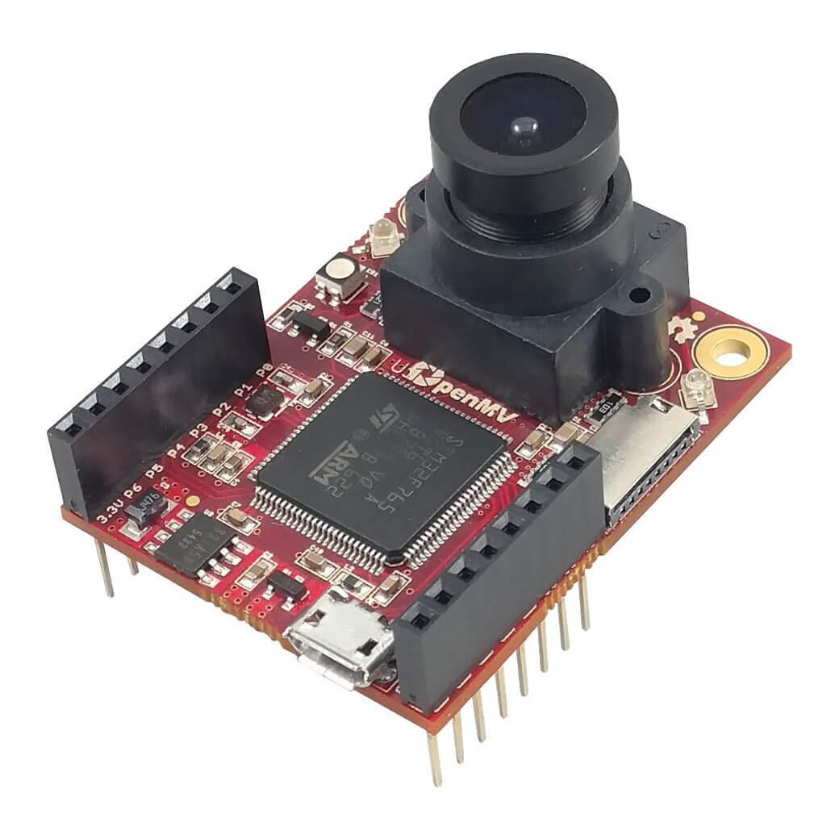
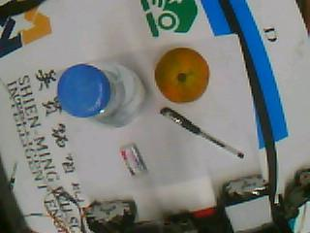
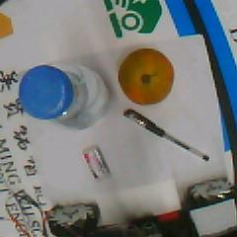
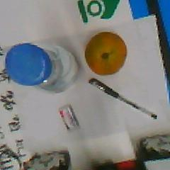
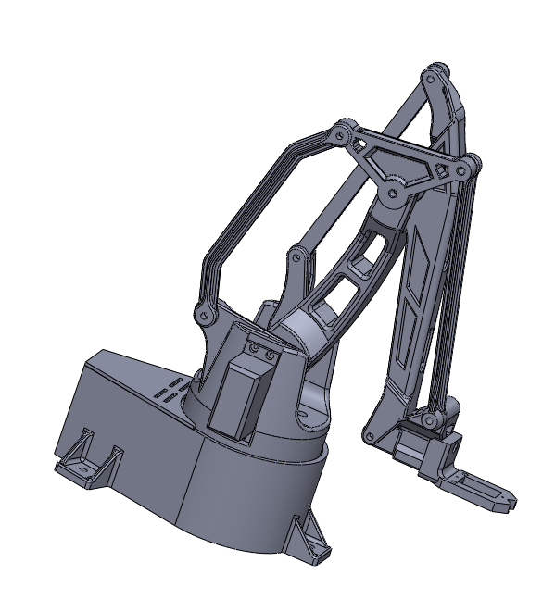
Grasping & Loading
Origin
windowing
len_cor
y’
x
mm coord
px coord
detecting
y
Notes:
For Grasping and Loading task, we used OpenMV to help us detect objects. We first do transformation to the snapshots that we’ve taken, then after windowing and len correction, we can detect object based on neural networks which I will cover in the next slide. Another thing we have to do is to map the pixel coordinates of our camera to milimeter coordinates of our robot arm. Finally send data to MCU through serial port.

Slide 16
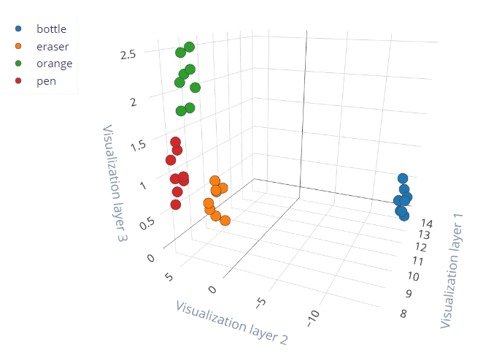
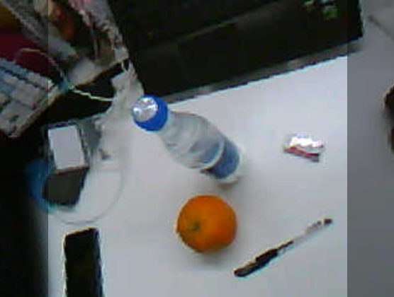
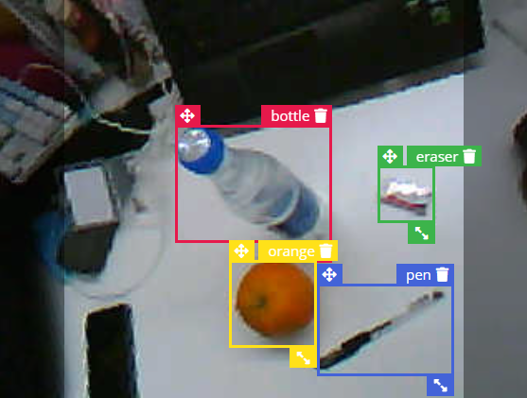
Grasping & Loading
Notes:
For object detection, we make use of convolutional neural networks based on keras. After taking few pictures of target objects and manually label it, we trained our network with head of mobile net. So whenever we take a snapshot, we input it into our network, processing it and generate features, finally the network can output possibilities of different labels, as well as its coordinates.

Slide 17
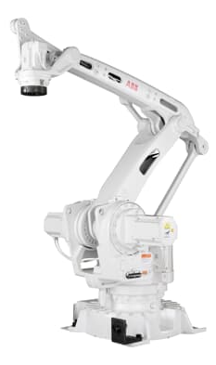
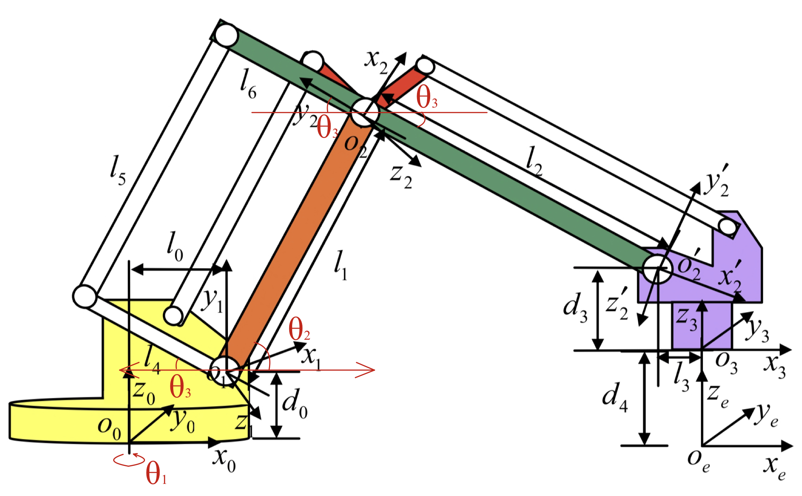
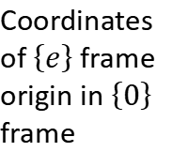
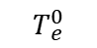
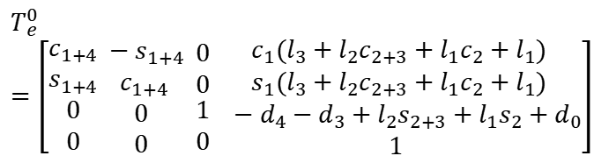
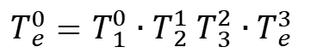
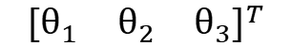
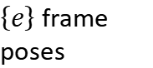
Grasping & Loading
Robot manipulator modeling & Denavit–Hartenberg parameters
$T_{e}^{0}=T_{1}^{0}∙T_{2}^{1}$ $T_{3}^{2}∙T_{e}^{3}$
ABB IRB460
Standard DH-parameters
$$T_{e}^{0}=\left[\begin{matrix}c_{1+4} \\ s_{1+4} \\ \begin{aligned}0 \\ 0\end{aligned}\end{matrix}\begin{matrix} −s_{1+4} \\ { c}_{1+4} \\ \begin{aligned}0 \\ 0\end{aligned}\end{matrix}\begin{matrix} 0 \\ 0 \\ \begin{aligned} 1 \\ 0\end{aligned}\end{matrix}\begin{matrix}{ c}_{1}(l_{3}+l_{2}c_{2+3}+l_{1}c_{2}+l_{1}) \\ { s}_{1}(l_{3}+l_{2}c_{2+3}+l_{1}c_{2}+l_{1}) \\ \begin{aligned} −d_{4}−d_{3}+l_{2}s_{2+3}+l_{1}s_{2}+d_{0} \\ 1\end{aligned}\end{matrix}\right]$$
Base frame
End effector frame
$$T_{e}^{0}$$
Coordinates of $\left\{e\right\}$ frame origin in $\left\{0\right\}$ frame
$\left\{e\right\}$ frame poses
Linkages frames
Inverse kinematic
$${\left[\begin{matrix}θ_{1} & θ_{2} & θ_{3}\end{matrix}\right]}^{T}$$
Joint space
Notes:
Our robot arm shares the kinematic designed with ABB IRB460 scaled down with a ratio of 1:7, which is widely applied in industry.
DH parameters are the four parameters associated with a particular convention for attaching reference frames to the links of a spatial kinematic chain.
Standard DH-parameter is applied to describe the linkages relationships.
Use DH-parameter to derive the homogeneous transformation from the base frame to the end effector frame, which is the basis of inverse kinematic.

Slide 18
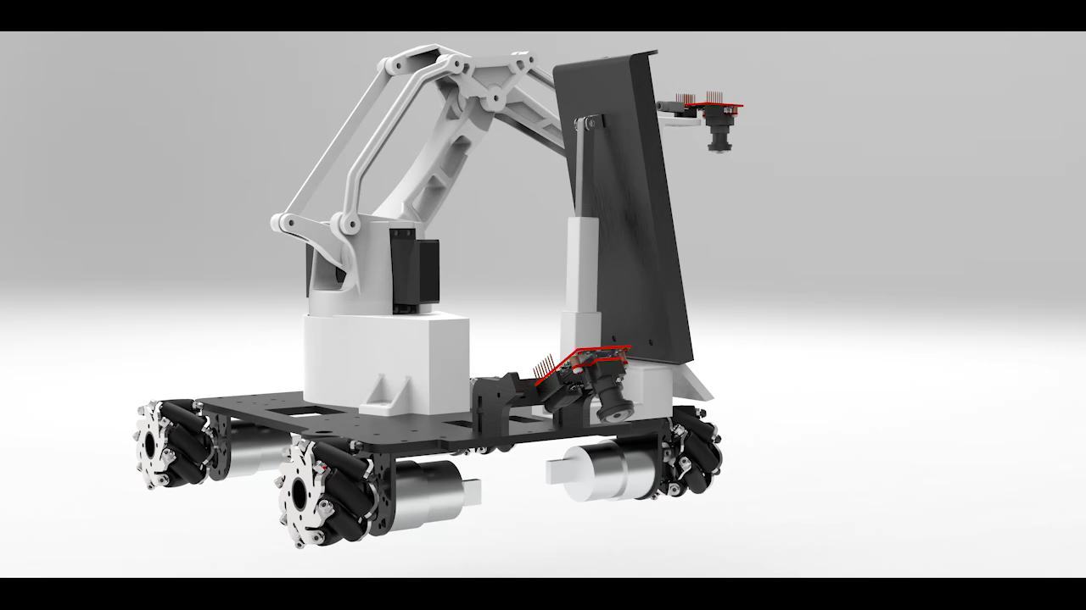
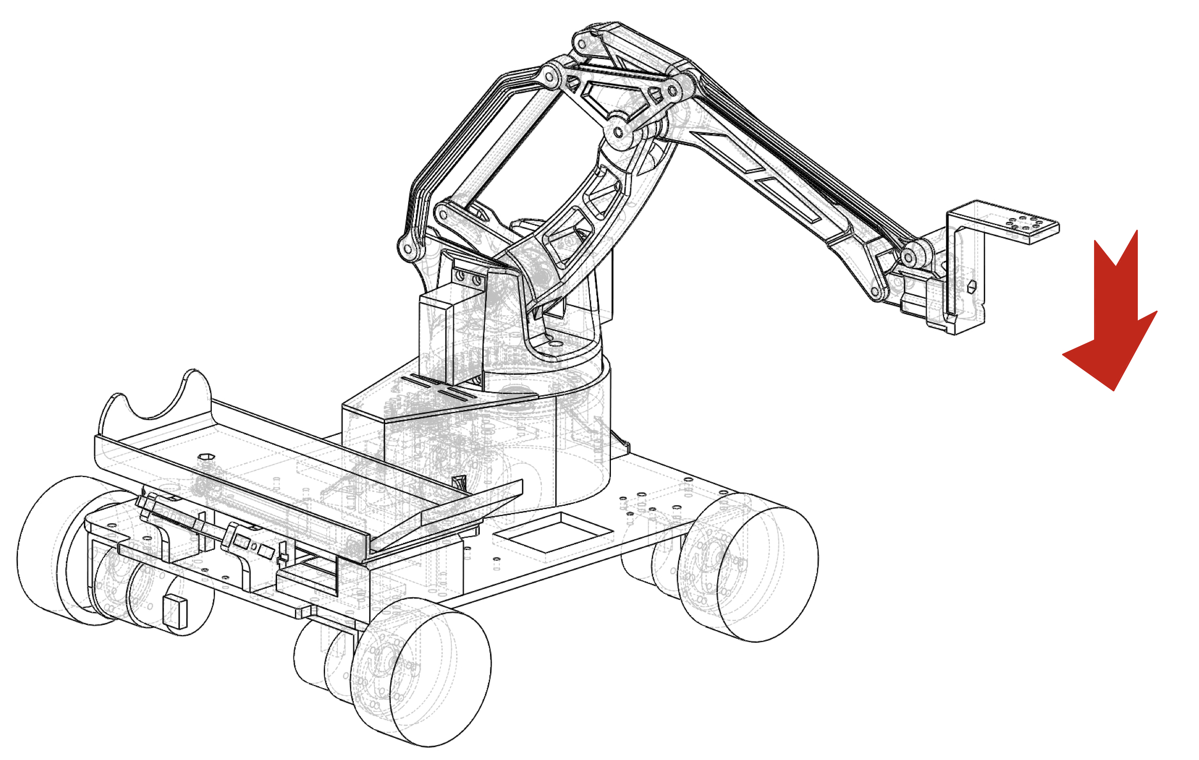
Grasping & Loading
Trajectory planning & Unloading machanism
Grasping
Loading mechanism
Notes:
The robotic arm is controlled by the servo, and the servo control depends on the PWM pulse width.
Due to the delay of the servo angle to the PWM change, in order to prevent the wrong transient end effector poses that causing the target object to be moved, we adopted trajectory planning, the last segment of the grasping only changes z coordinates.
Our unloading mechanism is driven by a linear actuator, with the longest and shortest positions corresponding to the vertical and horizontal states of the hopper respectively.

Slide 19
5
Conclusion
宋雨辰 / 齐睿

Slide 20
Conclusion
Tasks we done:
Obstacle avoidance with smooth speed control.
Path tracking with OPENMV camera
Cargo detection, positioning and classification.
Manipulator building and inverse kinematics analysis.
Problems along with the project:
Damage to hardware.
Unconsciousness for bad power output of batteries.
Less knowledge for hardware debugging.

Slide 21
THANK YOU FOR YOUR LISTENING!

Slide 22
Q&A

